Slide 1
GetActive@Home
Week 3
Stage 2
School Sport Unit

Slide 2
GetActive@Home
The GetActive@Home resources are available to support teachers and parents/carers in keeping students active either at home or to supplement Physical Education programs at school. There are 17 GetActive@Home episodes to engage students in K-2 and 3-6. The episodes and teacher resources are linked to the NSW PDHPE K-10 syllabus.
The resources in this PowerPoint can be included in the Week 3 remote learning unit of work to get students more active, more often, and to support schools in providing students with 150 minutes of physical activity each week as outlined in the Department of Education’s Sport and Physical Activity policy.
Further information, resources and skill activity packages can be found on the School Sport website.

Slide 3

GetActive@Home episodes
The GetActive videos aim to lead students through activities that will develop their foundational and specialised movement skill. Developing these skills is important for students to build the confidence and competence to participate in a range of physical activities during their school years and throughout the rest of their lives.
Further information, resources and skill activity packages can be found on the NSW School Sport website.
The GetActive@Home videos aim to lead students through activities that will develop their foundational and specialised movement skills. Developing these skills is important for students to build the confidence and competence to participate in a range of physical activities during their school years and throughout the rest of their lives.
The challenge tasks following each video provide students with fun and engaging activities to practise the movement skill.
Further information, resources and skill activity packages can be found on the School Sport website.

Slide 4
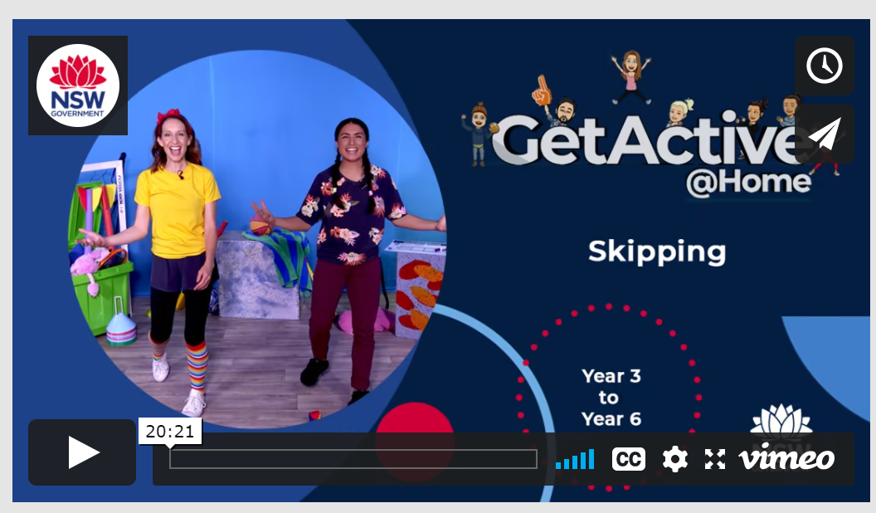
Day 1
Skipping
Follow the link below to watch the episode and join in the skipping fun with Michele and Teresa.
GetActive@Home – Episode

Slide 5
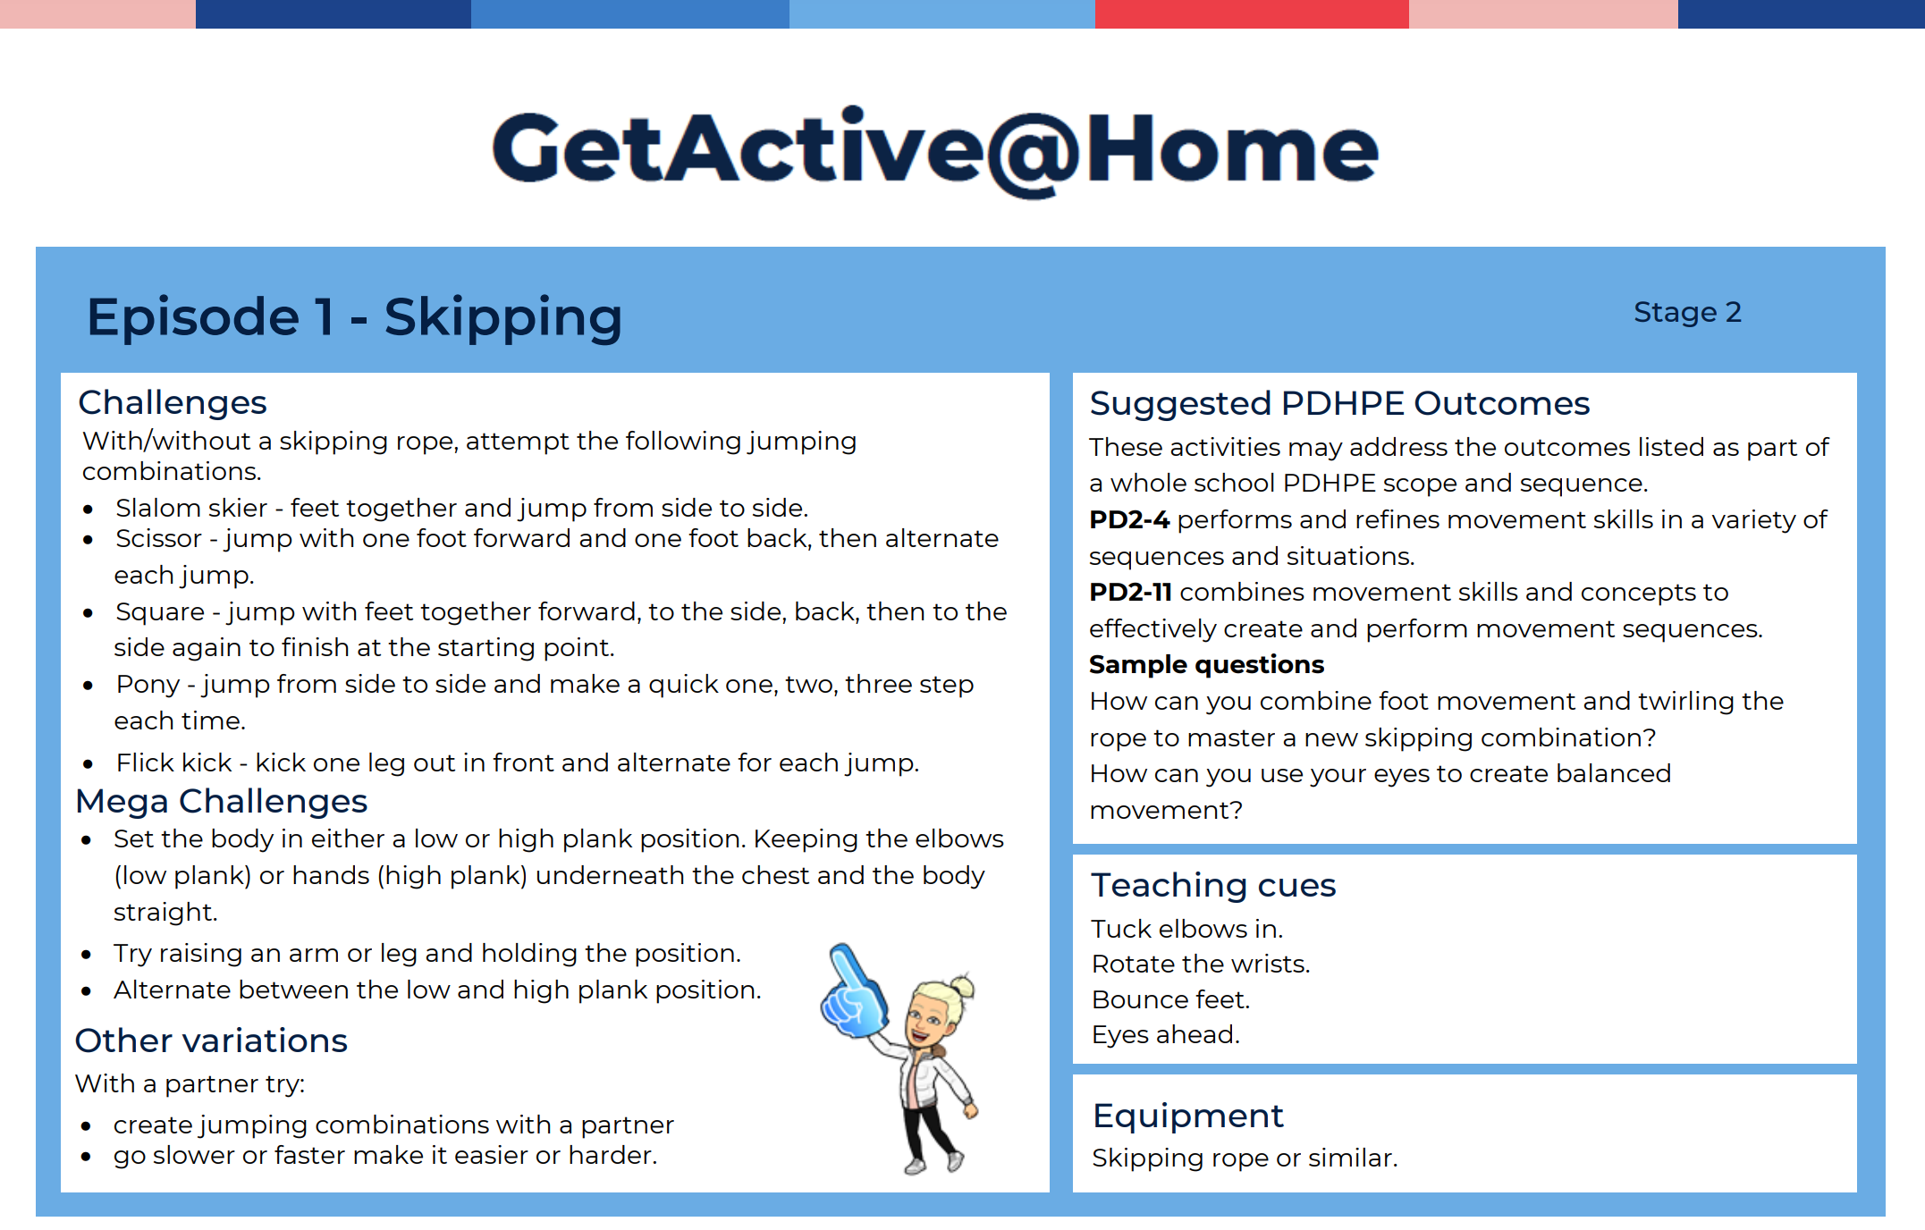
Skipping challenges

Slide 6
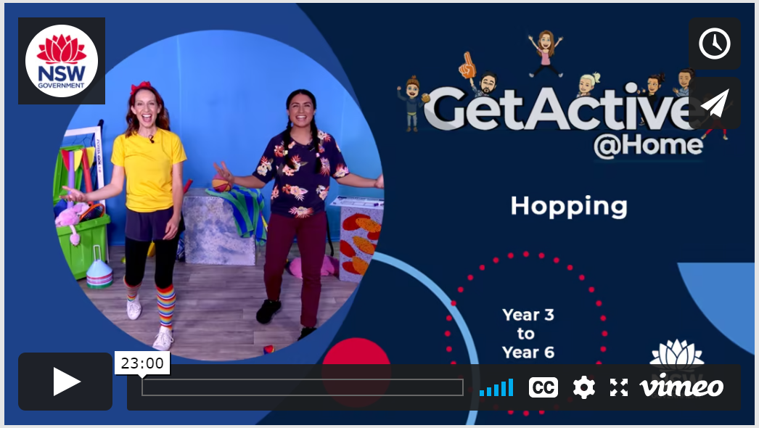
Day 2
Hopping
Follow the link below to watch the episode and join in the hopping fun with Michele and Teresa.
GetActive@Home – Episode

Slide 7
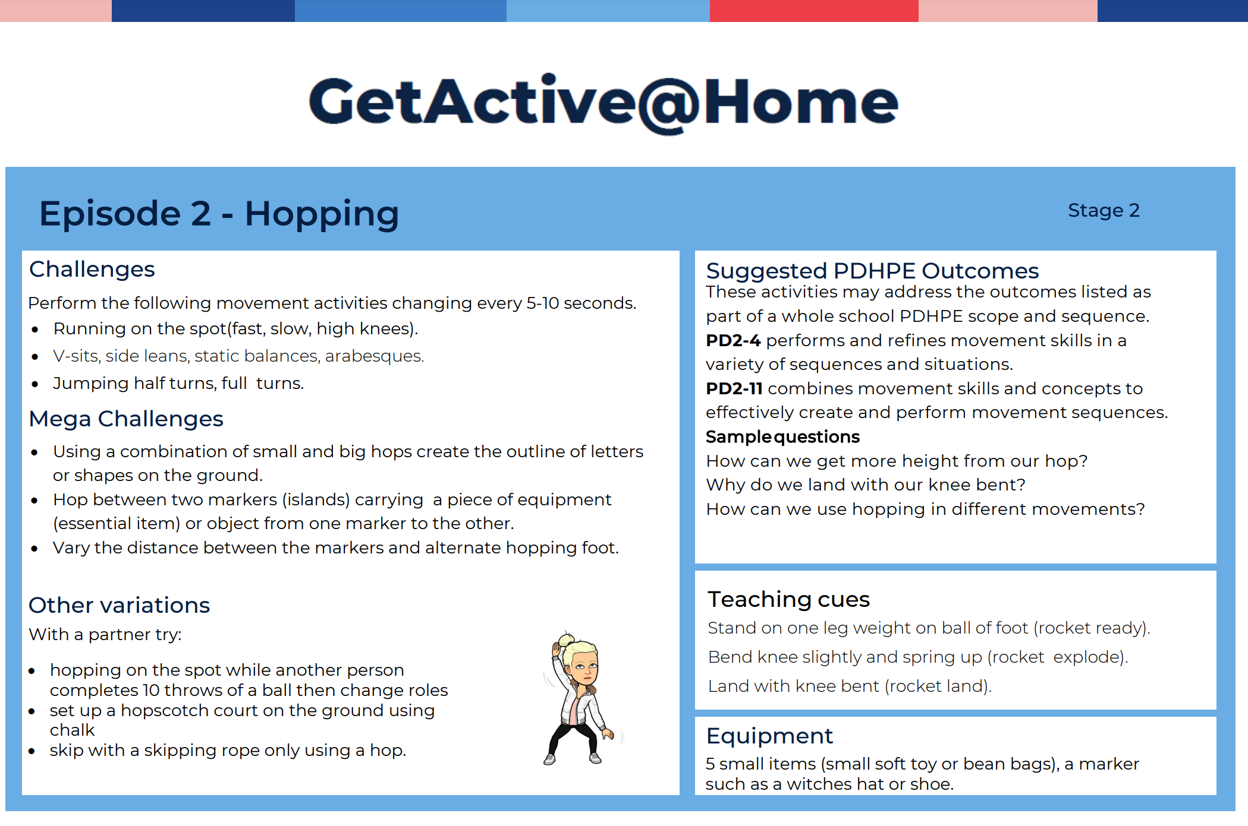
Hopping

Slide 8
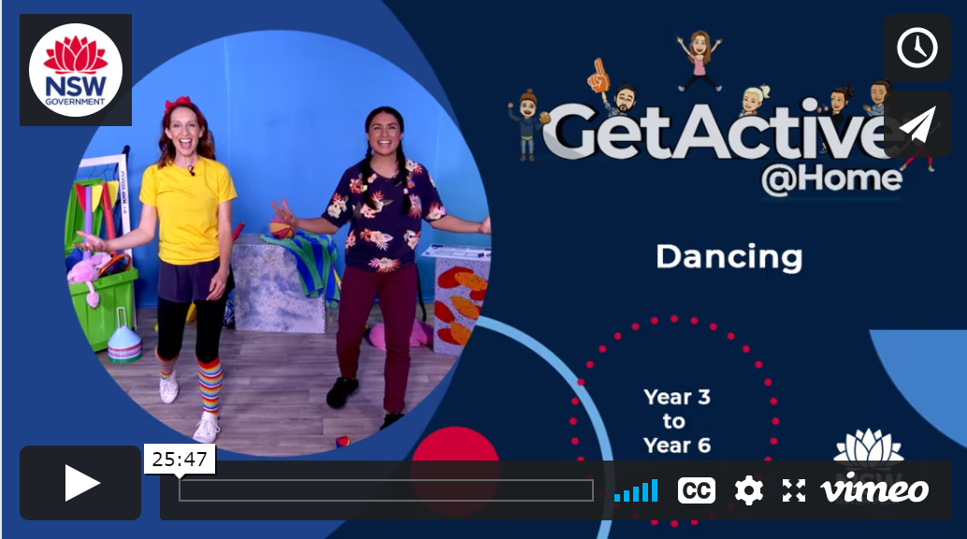
Day 3
Dancing
Follow the link below to watch the episode and join in the dancing fun with Michele and Teresa.
GetActive@Home – Episode

Slide 9
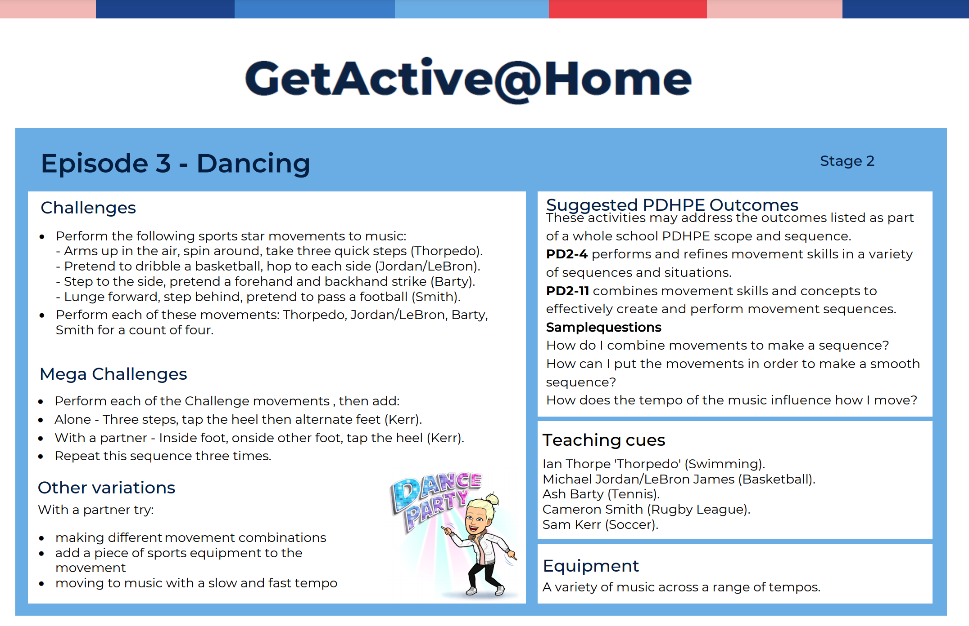
Dancing

Slide 10
Resources
Follow the links below to view and/or print the GetActive@Home resources
Activity logbook
Active challenger award
3 - 6 student homework proforma

