Slide 1
Thinking while Moving
English learning from home tasks
School Sport Unit

Slide 2

Thinking while Moving
Thinking while Moving (TwM) is based on Dr Nick Riley's EASY (Encouraging Activity to Stimulate Young Minds) research that measured the impact of children's daily school time physical activity levels, their engagement and 'on task' behaviour in mathematics and English. These resources support teachers in enhancing student engagement during remote learning.
Thinking while Moving was developed as part of the Department of Education’s response to the NSW Auditor General's report into physical activity in government primary schools. The aim is to invigorate the current primary curriculum and attempt to maximise opportunities to incorporate movement-based learning into key learning areas. Thinking while Moving is an excellent teaching approach to ensure students are active, healthy and engaged in their learning.

Slide 3
Thinking while Moving at Home
The resources in this PowerPoint can be included in remote learning units of work to get students more active, more often, and to support schools in providing students with 150 minutes of physical activity each week as outlined in the Department of Education’s Sport and Physical Activity policy.
Further information and resources can be found on the School Sport website.

Slide 4
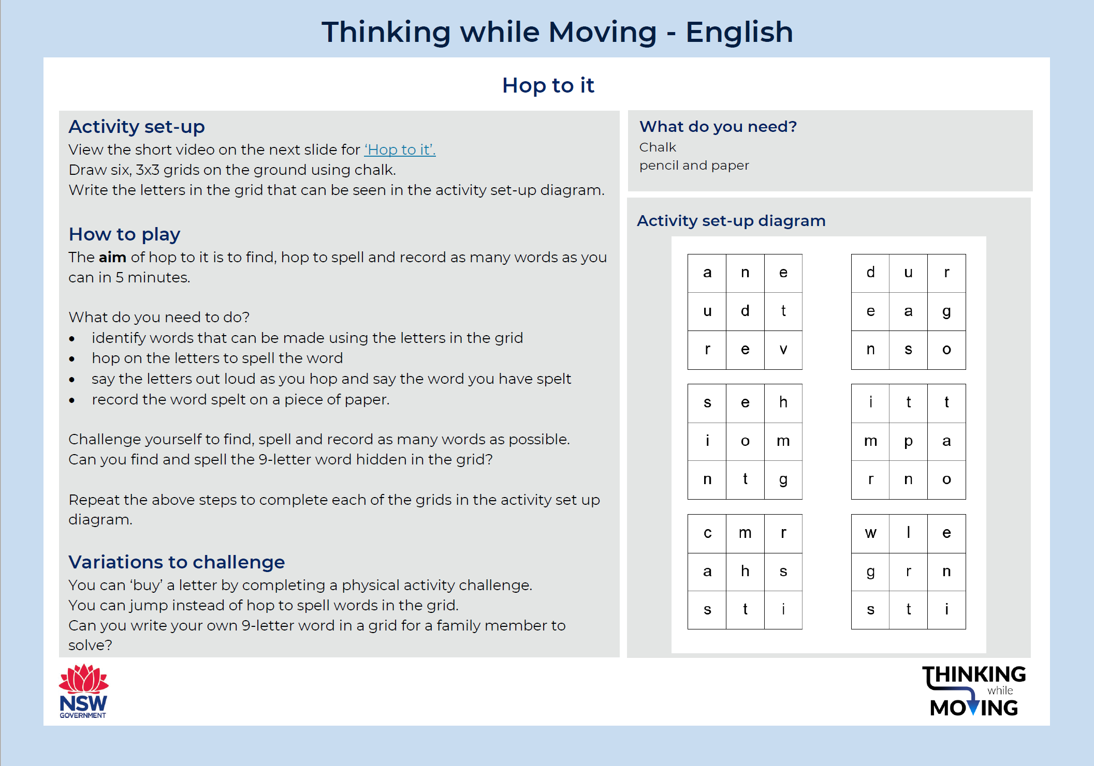
Learning task 1

Slide 5
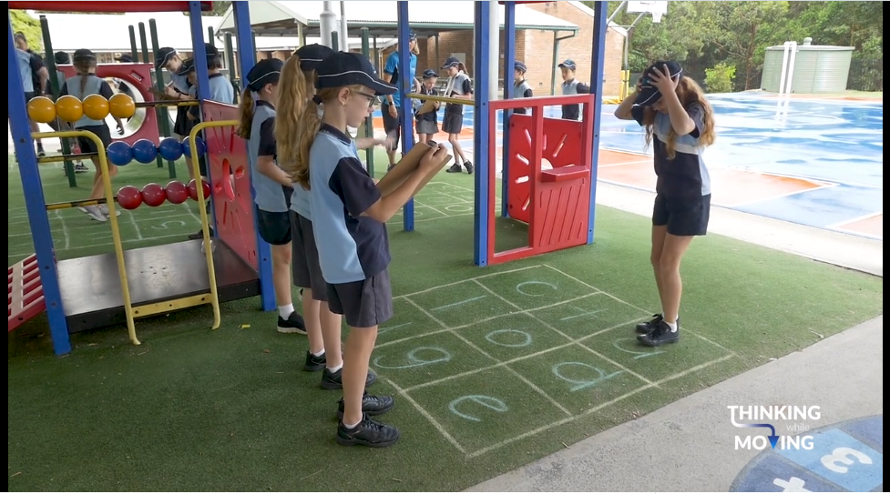
Hop to it
Follow this link to view how to play ‘hop to it’.

Slide 6
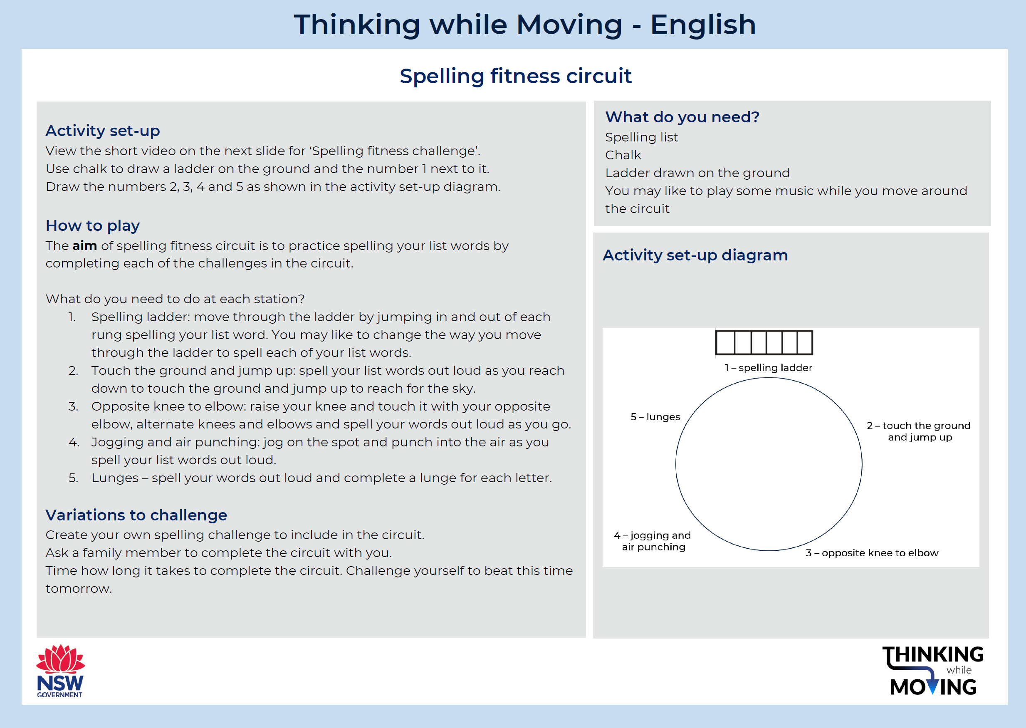
Learning task 2

Slide 7

Spelling fitness circuit
Follow this link to view how to complete the spelling fitness circuit

Slide 8
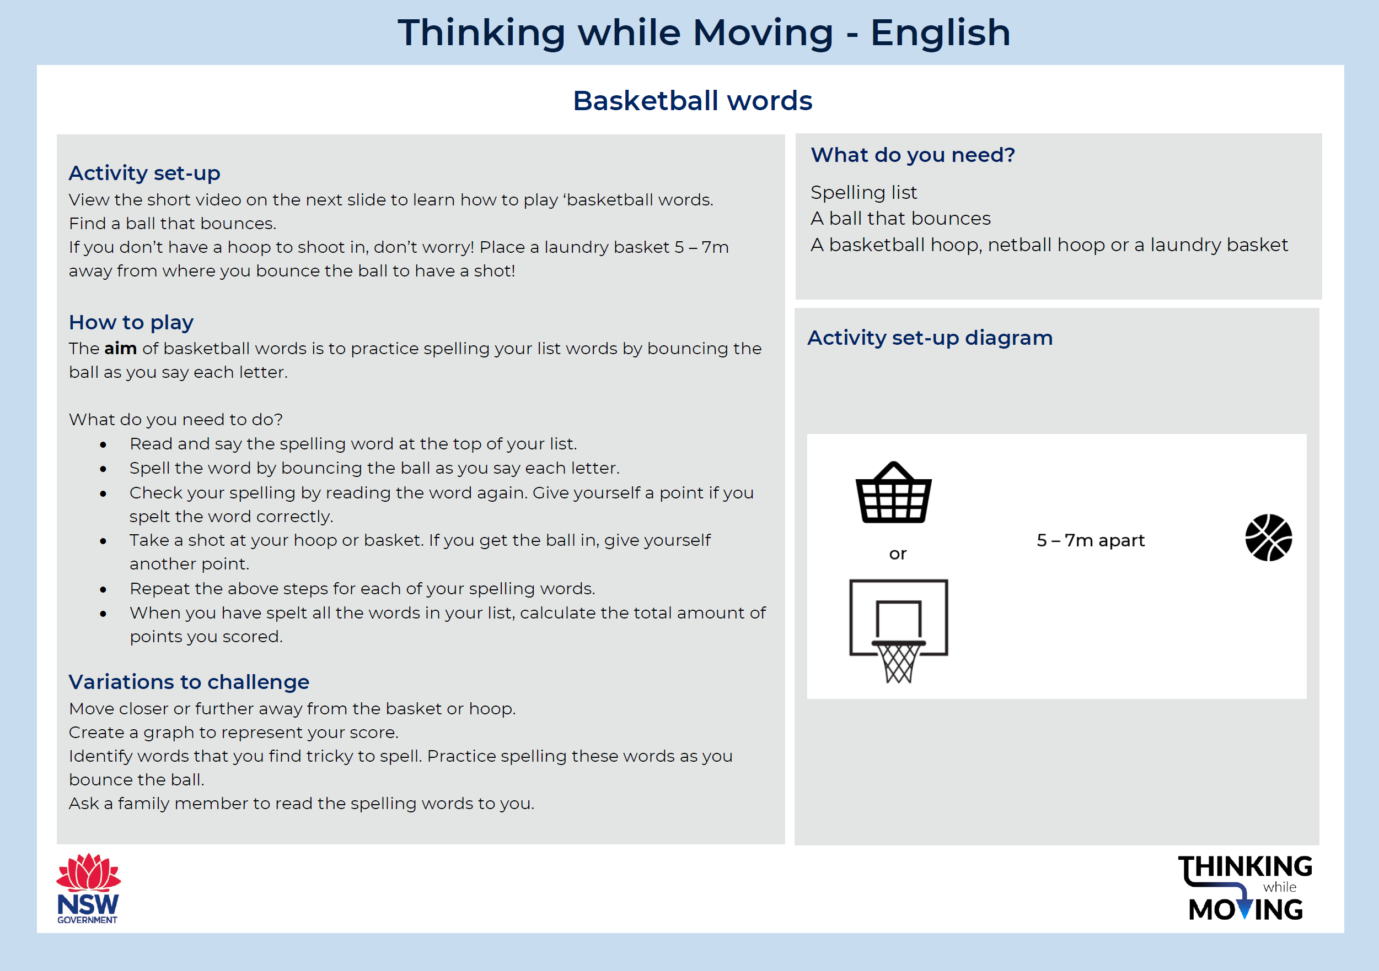
Learning task 3

Slide 9
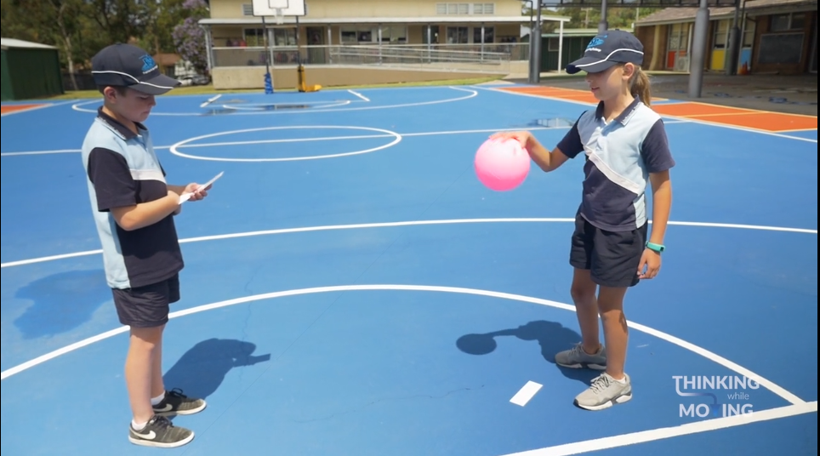
Basketball words
Follow this link to view how to play ‘basketball words’

Slide 10
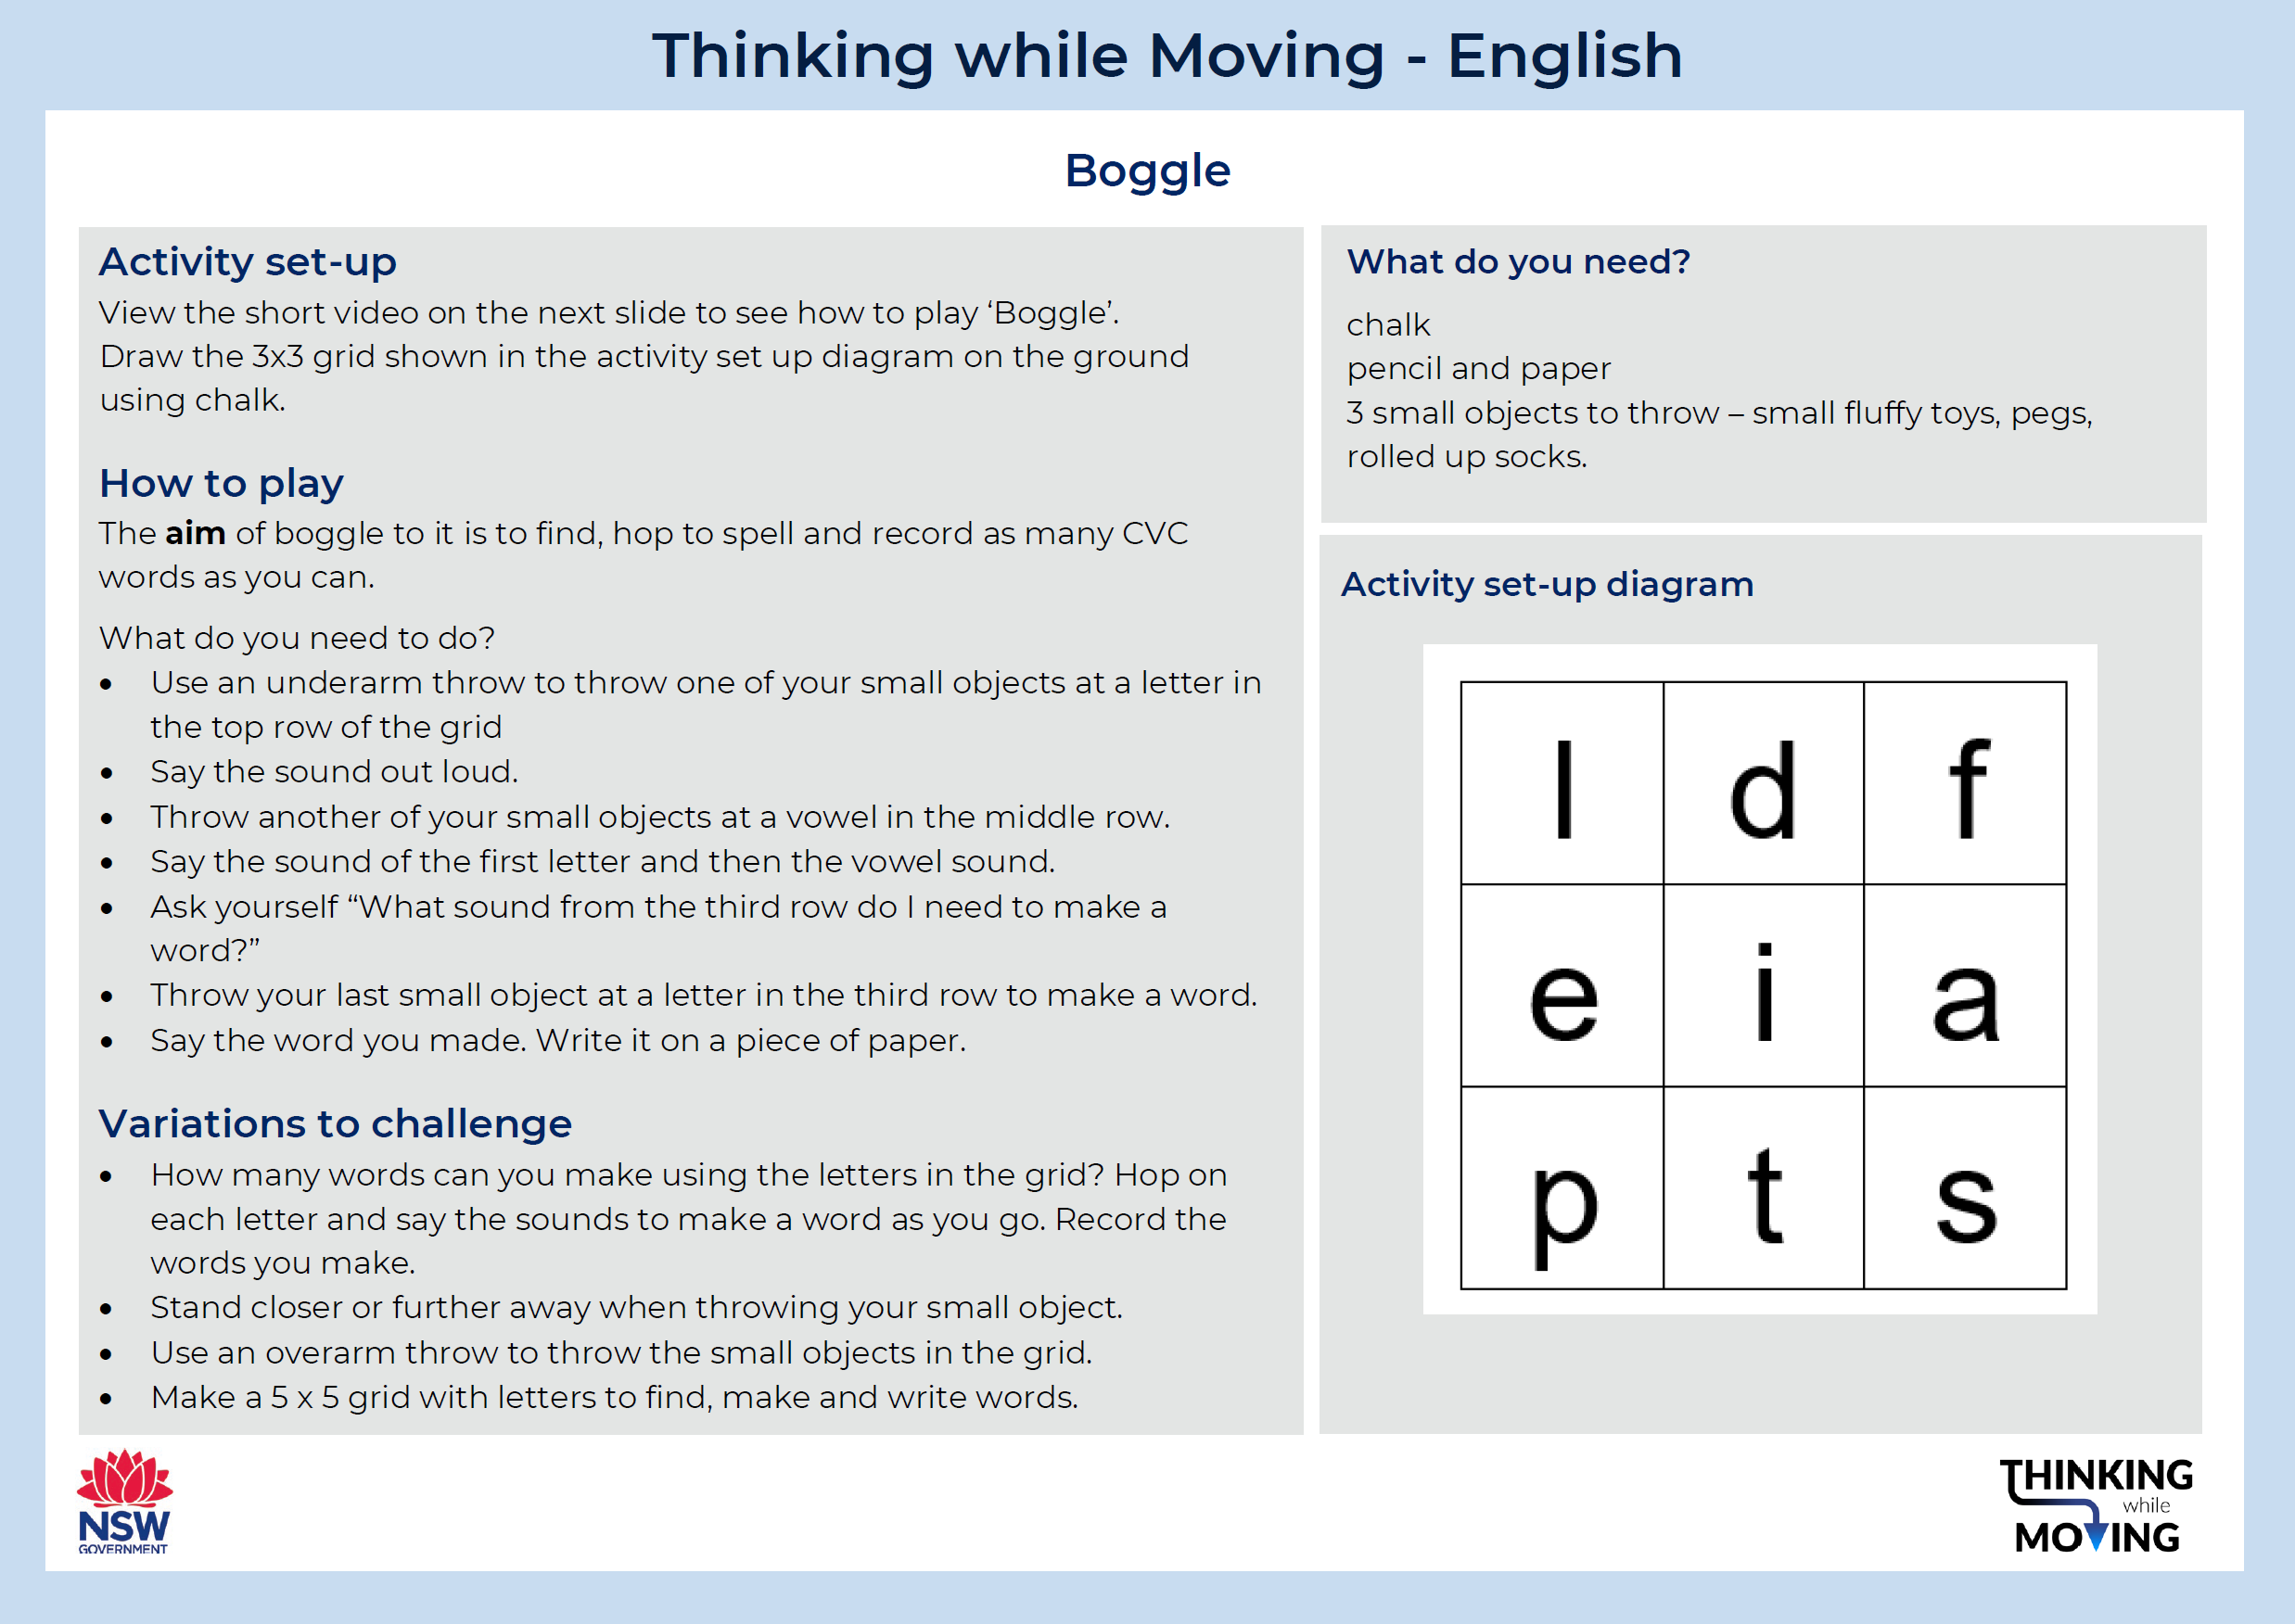
Learning task 4

Slide 11
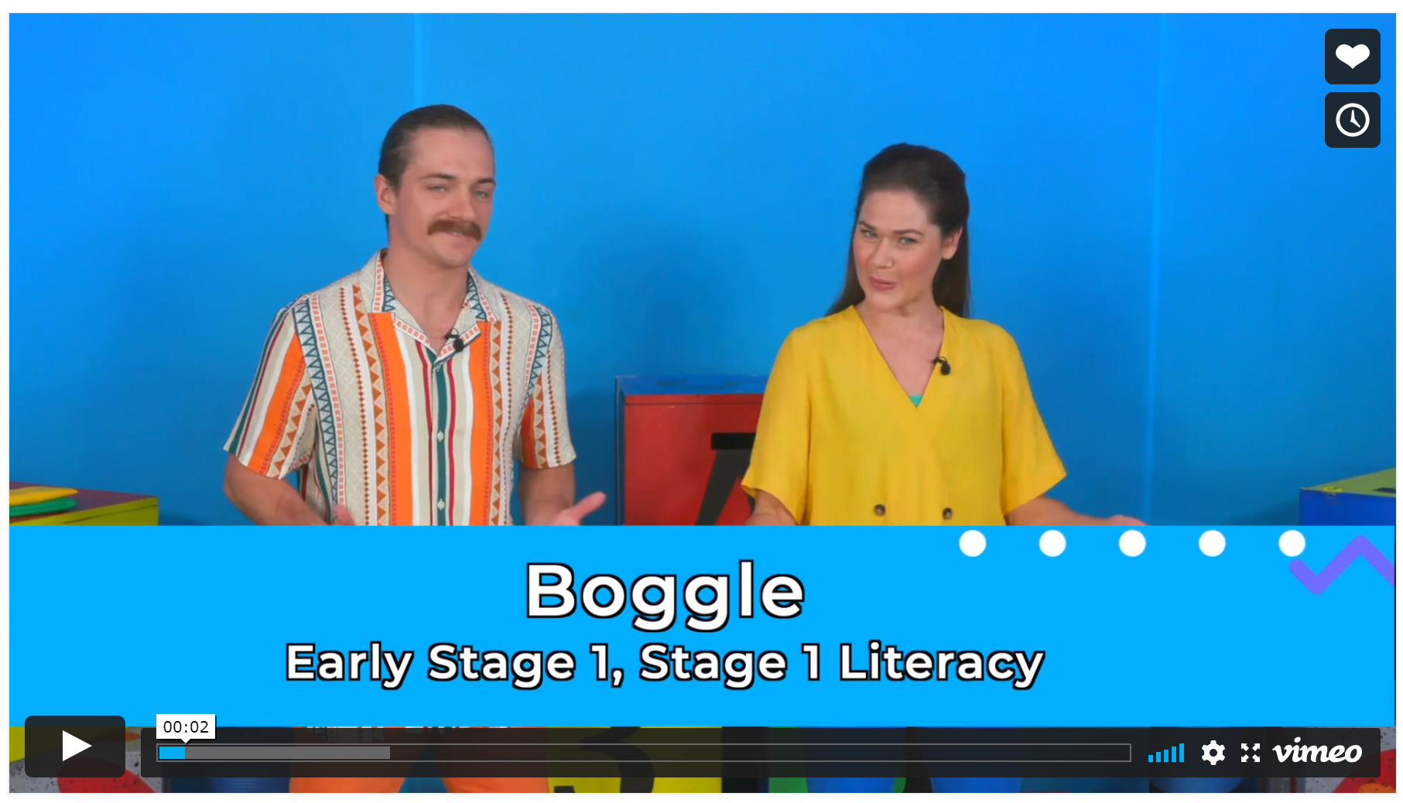
Boggle
Follow this link to view how to play ‘boggle’

Slide 12
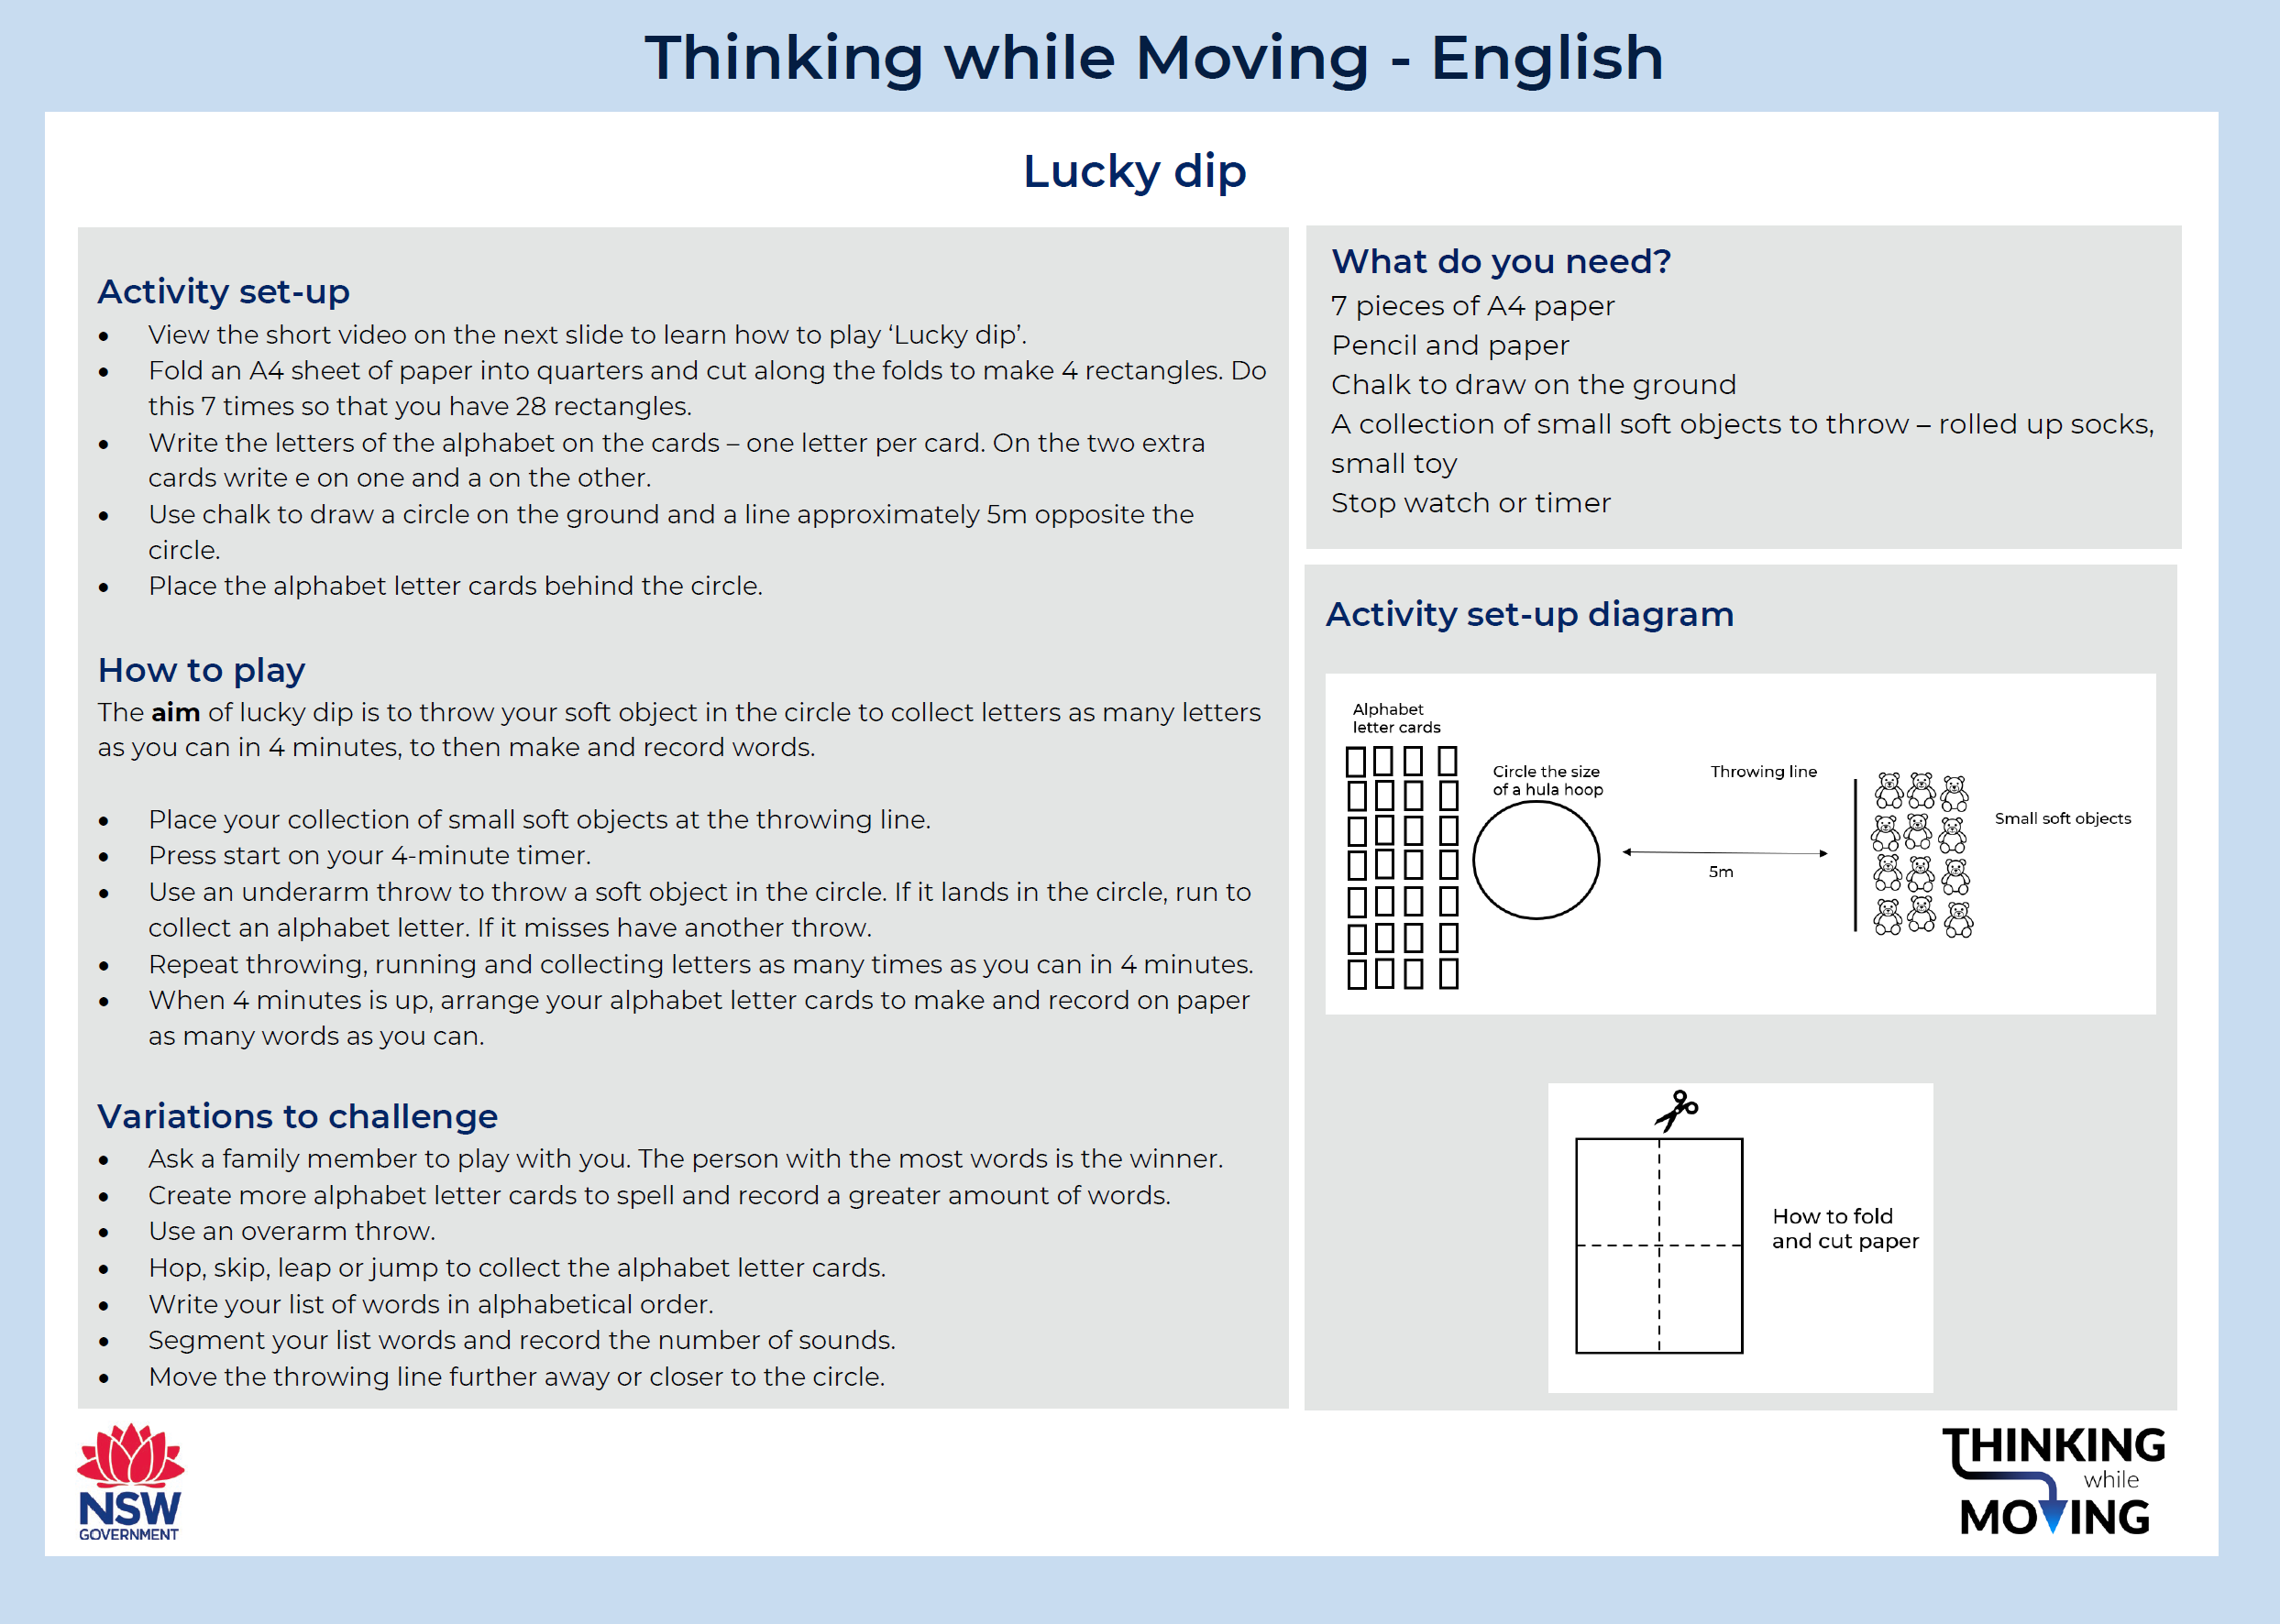
Learning task 5

Slide 13

Lucky dip
Follow this link to view how to play ‘lucky dip’

Slide 14
Resources
Follow the links below to view more Thinking while Moving resources:
Thinking while Moving in mathematics lesson plans
Thinking while Moving in English lesson plans
Who wants to be smart and active? PowerPoint lessons
Thinking while Moving eLearning course
Overview of Thinking while Moving
Professional learning opportunities

